Slide 1
Assessing Patient-Reported Outcomes in Clinical Trials
Michael Brundage MD MSc FRCP(C)
New Investigators Course, Kingston 2022

Slide 2
Disclosure:
The PROTEUS Consortium is funded by an unrestricted project grant from Pfizer Medical (Co-PI)

Slide 3


Slide 4
Brief History
1979: NCIC (now CCSRI) decides to have a formal
cooperative clinical trials group
1980: NCIC Clinical Trials Group established at
Queen’s University (Dr. Pater)
1982: First Phase III Trial with QOL (BR.5)

Slide 5
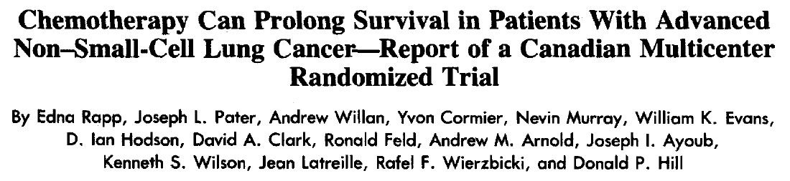
Brief History

Slide 6
BR.5 QOL
Shortly after the trial started, centres were asked to participate in the QOL component of the trial
  They were given the option to use both Sickness Impact Profile (SIP) and Functional Living Index –Cancer (FLIC) questionnaires, only FLIC, or not participate
Almost all centres agreed to participate and most chose to use both instruments

Slide 7
BR.5 QOL
Low compliance (<25%) with QOL collection in BR.5 was due to many factors
Evident that QOL measurement would not “just happen” …

Slide 8







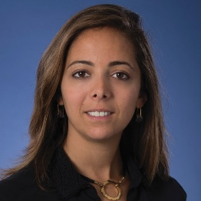
Advocating for Quality of Life Outcomes
Winson Cheung
Joelle Helou

Slide 9
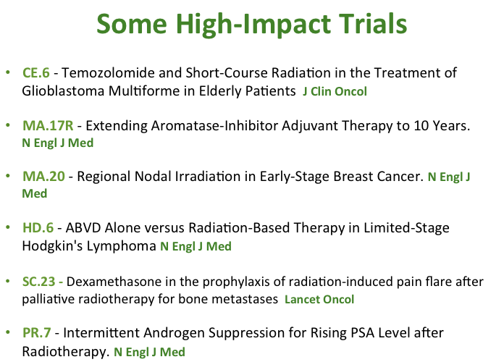


Slide 10


Slide 11
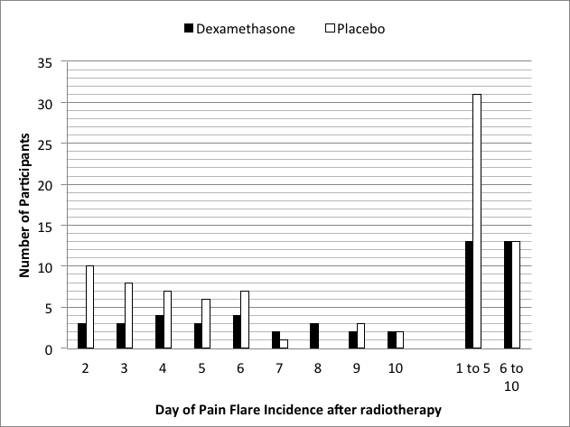


Slide 12


Slide 13
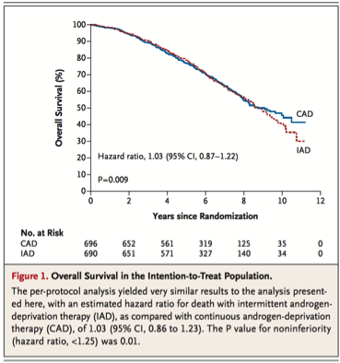
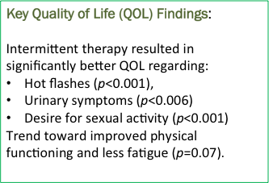

Slide 14
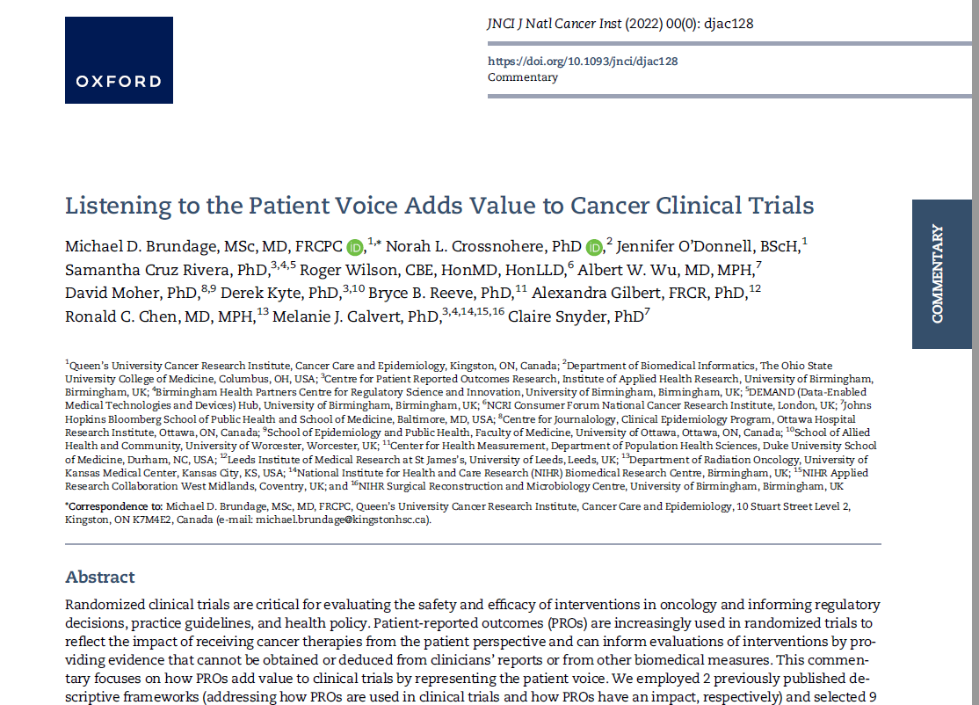

Slide 15
Patient-Reported Outcomes (PROs)
“A PRO is any report of the status of a patient’s health condition that comes directly from the patient, without interpretation of the patient’s response by a clinician or anyone else.”
https://www.fda.gov/media/77832/download

Slide 16
Types of Clinical Outcomes Assessment
Based on standardized task(s) performed by a patient
Examples: treadmill exercise test, cognition, and attention
Reported directly by patient
Examples: global impression, functional status, well-being, symptoms, health-related quality of life
Performance
(PerfO)
Patient-Reported
(PRO)
Clinical Outcomes Assessment
Reported by someone other than the patient or a health professional
Examples: seizure frequency, surgical scar appearance
Observer-Reported
(ObsRO)
Clinician-Reported
(ClinRO)
Reported by a trained health-care professional
Examples: treatment toxicity, disease severity
https://www./clinical-outcome-assessment-compendiumfda.gov/drugs/development-resources

Slide 17
60
60

Slide 18

60
Indicator of patient status
Measurement method is familiar
Measurement scale is familiar
Clinical interpretation is familiar

Slide 19
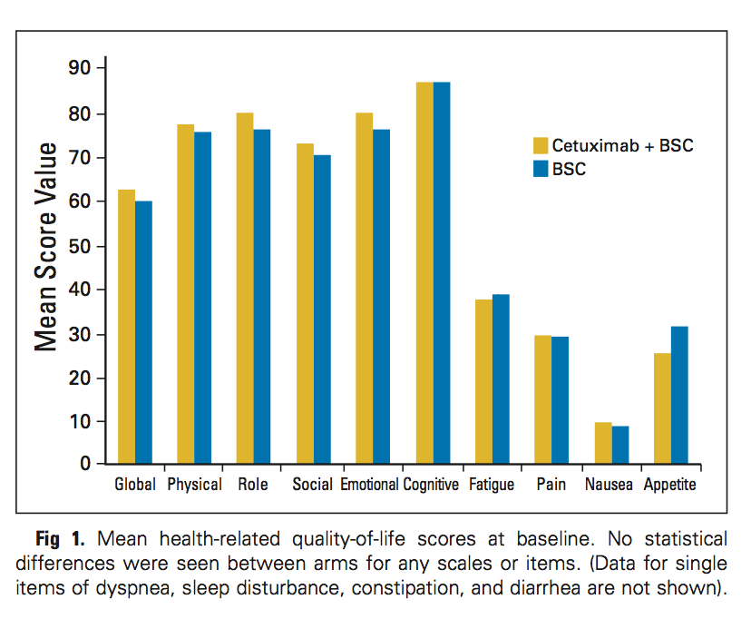
60
Indicator of patient status
Measurement method is less familiar
Measurement scale is less familiar
Clinical interpretation challenging

Slide 20
Challenges to Clinicians
Variation in PRO instruments
  Over 800 listed in PROQOLID database (http://proqolid.org/)
Variation in scoring
  Higher scores may be better or worse
Variation in scaling
  E.g, 0-100 vs. normed to 50
Variation in presentation
  E.g., mean scores vs. responders
  E.g., graphic vs. tabular

Slide 21
How are Patient Perceptions ‘Measured’? i.e. Turned Into Valid and Reliable Data
Standardization is the key!
Ask a standard set of questions
Provide a standard set of response options
Allocate numbers to those response options in a standard way
Use a standard analysis and reporting algorithm
Great care must the taken in developing the questions, response options, and scoring algorithms during the development of PRO questionnaires (also called ‘tools’ and ‘measures’)

Slide 22
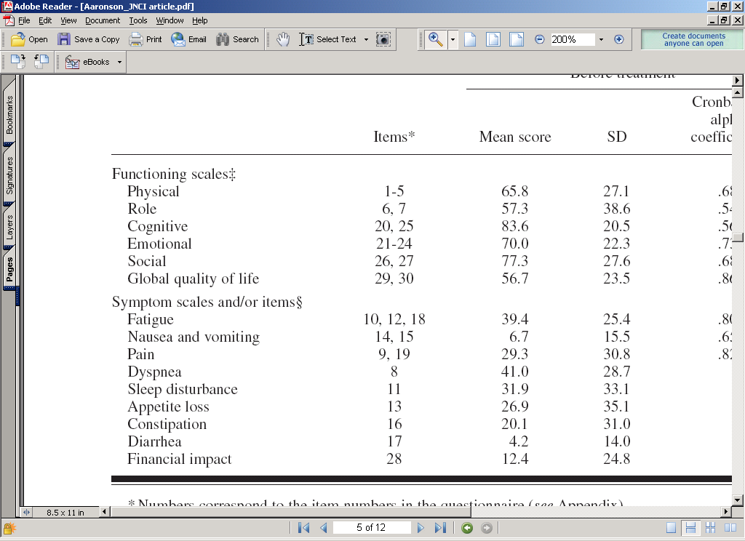
Do you have any trouble doing strenuous activities like carrying a heavy shopping…
Do you have any trouble taking a long walk
Do you have to stay in bed or a chair for most of the day

Slide 23
Do you have any trouble concentrating on things, like reading a newspaper or watching television?
Have you had difficulty remembering things?

Slide 24
Has your physical condition or medical treatments interfered with your family life?
Has your physical condition or medical treatments interfered with your social activities?

Slide 25
EORTC QLQ-C30+3 Instrument
Domain: Global quality of life
How would you rate your overall health during the past week?
1 2 3 4 5 6 7
Very poor
Excellent
How would you rate your overall quality of life during the past week?
1 2 3 4 5 6 7
Very poor
Excellent

Slide 26
Example:
Physical Function Measure
Raw Score (Mean of Component Items)= (3+3+2+2+1)/5=2.2
[1-(2.2-1)/3]*100=
60

Slide 27
Treatment Intent: Improve QOL
Mean 71.2
QOL
Score
Mean 60.8

Slide 28
Treatment Intent: Improve QOL
QOL
Score

Slide 29
Treatment Intent: Improve QOL
QOL
Score

Slide 30
Treatment Intent: Improve QOL
QOL
Score

Slide 31
Treatment Intent: Improve QOL
QOL
Score

Slide 32
Treatment Intent: Improve QOL
QOL
Score

Slide 33
Treatment Intent: Improve QOL
Percent
of
Patients

Slide 34
Some Concerns….
Problem of missing data – potential bias in QOL results

Slide 35
Treatment Intent: Improve QOL
QOL
Score

Slide 36
Treatment Intent: Improve QOL
QOL
Score

Slide 37
Treatment Intent: Improve QOL
QOL
Score

Slide 38
The Science of PROs in Trials
Trial Protocol Development
Trial Accrual and Follow-up
Trial Analysis
Trial Reporting
Clinical Uptake of Trial Findings
High-Quality PRO Evidence
Notes:
DC comment on CS/MB version 15 Sept: FINAL

Slide 39
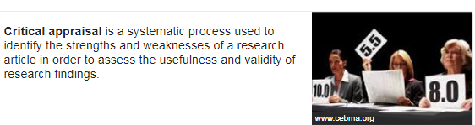

Slide 40


Slide 41
TheProteusConsortium.org
Patient-Reported Outcomes Tools:
Engaging Users & Stakeholders
Notes:
This is replica of original CS slide (no PROTEUS theme)

Slide 42
The PROTEUS Consortium
OBJECTIVE
Ensure that patients, clinicians, and other decision-makers have high-quality PRO data from clinical trials to make the best decisions they can about treatment options
APPROACH
Partner with key stakeholder groups to disseminate and implement tools that have been developed to optimize the use of PROs in clinical trials

Slide 43
Organizations with PROTEUS Participants*
AcademyHealth | Industry (GlaxoSmithKline)
American Cancer Society | International Society for Quality of Life Research
American Society for Radiation Oncology | ISPOR
American Society of Clinical Oncology | Medical journal editors
Australian Clinical Trials Alliance | Medicines and Healthcare Products Regulatory Agency
Canadian Association of Radiation Oncology | National Cancer Institute
Cancer Australia | National Cancer Research Institute (UK)
Consolidated Standards for Reporting of Trials (CONSORT) | National Clinical Trials Network PRO representatives
Critical Path Institute PRO Consortium | National Coalition for Cancer Survivorship
European Medicines Agency-Scientific Advice Working Party / Dutch Medicines Evaluation Board | National Institute for Health and Care Excellence
 | Oncology Nursing Society
European Organization for the Research and Treatment of Cancer (EORTC) | Patient-Centered Outcomes Research Institute
Food & Drug Administration (FDA) | Society for Clinical Trials
Health Canada | Standard Protocol Items: Recommendations for Interventional Trials (SPIRIT)
*Participation in PROTEUS does not imply endorsement of any particular PRO tools or guidance documents

Slide 44









Trials Steering Committee
Principal Investigator
Claire Snyder, PhD
Johns Hopkins School of Medicine
Melanie Calvert, PhD
University of Birmingham
Bryce Reeve, PhD
Duke University
Madeleine King, PhD
University of Sydney
Project Scientist
Norah Crossnohere, PhD
Ohio State University
Albert Wu, MD, MPH
Johns Hopkins
Bloomberg School of Public Health
Principal Investigator
Michael Brundage, MD, MSc
Queen’s Cancer Research Institute
Andrew Bottomley, PhD
European Organization for the
Research and Treatment of Cancer
Elissa Thorner, MHS
Patient Advocate

Slide 45
The PROTEUS Consortium’s Objective
Ensure that patients, clinicians, and other decision-makers have high-quality PRO data from clinical trials
Requires a SMART approach:
  Specifying the PRO methods appropriately
  Measuring the PROs effectively
  Analyzing the PRO data properly
  Reporting the PRO results clearly
  Translating the PRO findings in practice

Slide 46
The PROTEUS Consortium’s Rationale
Clinical trial protocols are often sub-optimal with regard to their PRO components
Clinical trial reporting of the PRO components is often sub-optimal or doesn’t happen at all
  Tools are available to improve trial protocol design, execution, reporting and uptake with regard to PRO endpoints

Slide 47
PROTEUS Roadmap
Trial Protocol Development
Trial Accrual and Follow-up
Trial Analysis
Trial Reporting
Clinical Uptake of Trial Findings
High-Quality PRO Evidence
SPIRIT
PRO
Protocol
Guidance
ISOQOL
PRO
Measure
Selection Standards
PRO
Data Display Guidance
SISAQOL
Analysis
Guidance
CONSORT
PRO
Report
Guidance
Clinician
Users’
Guide
Notes:
DC comment on CS/MB version 15 Sept: FINAL

Slide 48
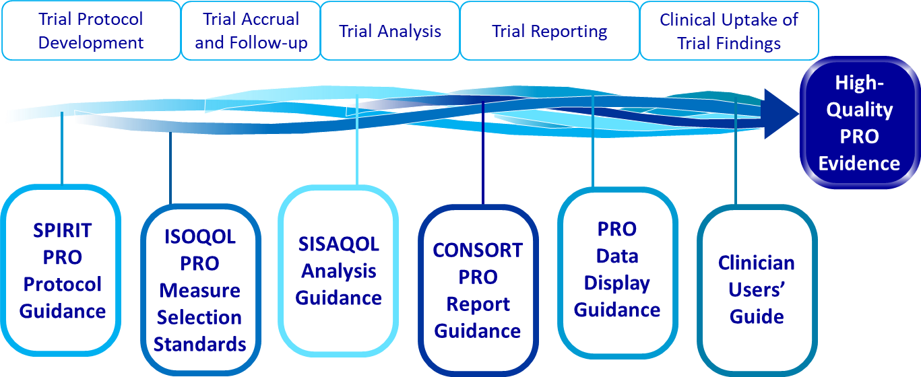
“6 Tool-1 Paper Paper”

Slide 49
Specifying PRO Methods Appropriately
Trial Protocol Development
Trial Accrual and Follow-up
Trial Analysis
Trial Reporting
Clinical Uptake of Trial Findings
High-Quality PRO Evidence
SPIRIT
PRO
Protocol
Guidance
ISOQOL
PRO
Measure
Selection Standards
PRO
Data Display Guidance
SISAQOL
Analysis
Guidance
CONSORT
PRO
Report
Guidance
Clinician
Users’
Guide

Slide 50
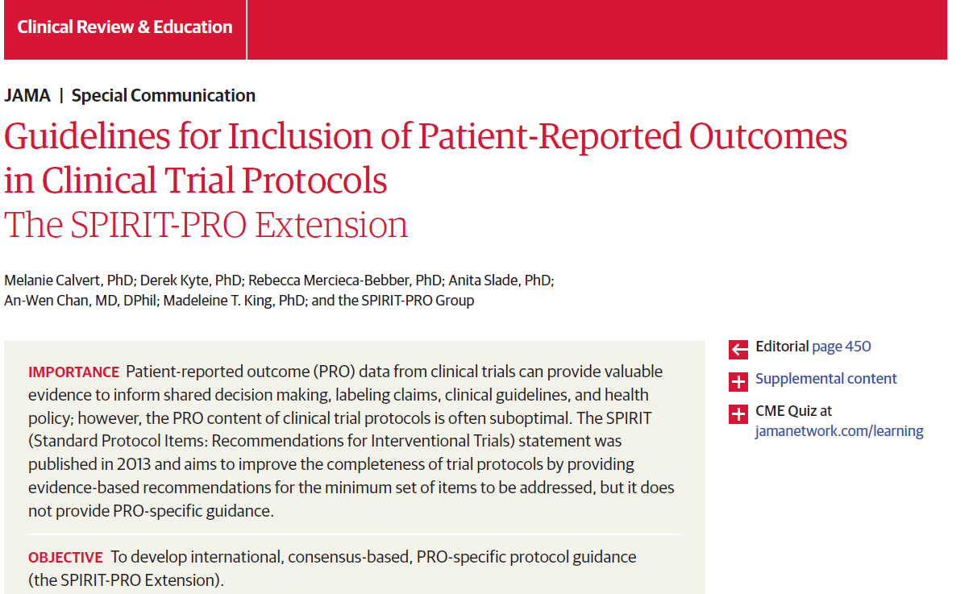
Specifying PRO Methods Appropriately
PRO-specific research question, rationale, relevant previous findings
PRO-specific objectives or hypotheses
PRO-specific eligibility criteria (if any)
PRO concepts/domains and related analysis metric used to evaluate the intervention
PRO measure description and psychometrics
Data collection plan
Available language versions
Justification for proxy reporting (if relevant)
Strategies to minimize and address missing data
Whether PRO data will be monitored to inform care
Calvert et al, JAMA
2018, 319(5), 483-494
Notes:
CS&MB: Delete the title header for each of the “publication” slides – it’s readily apparent that it’s a publication
DC: done
DC:
- another example of “do we need a text box citation?”
- Example of black outline

Slide 51
Measuring PROs Effectively
Trial Protocol Development
Trial Accrual and Follow-up
Trial Analysis
Trial Reporting
Clinical Uptake of Trial Findings
High-Quality PRO Evidence
SPIRIT
PRO
Protocol
Guidance
PRO
Data Display Guidance
SPIRIT
PRO
Protocol
Guidance
ISOQOL
PRO
Measure
Selection Standards
ISOQOL
PRO
Measure
Selection Standards
SISAQOL
Analysis
Guidance
CONSORT
PRO
Report
Guidance
Clinician
Users’
Guide

Slide 52
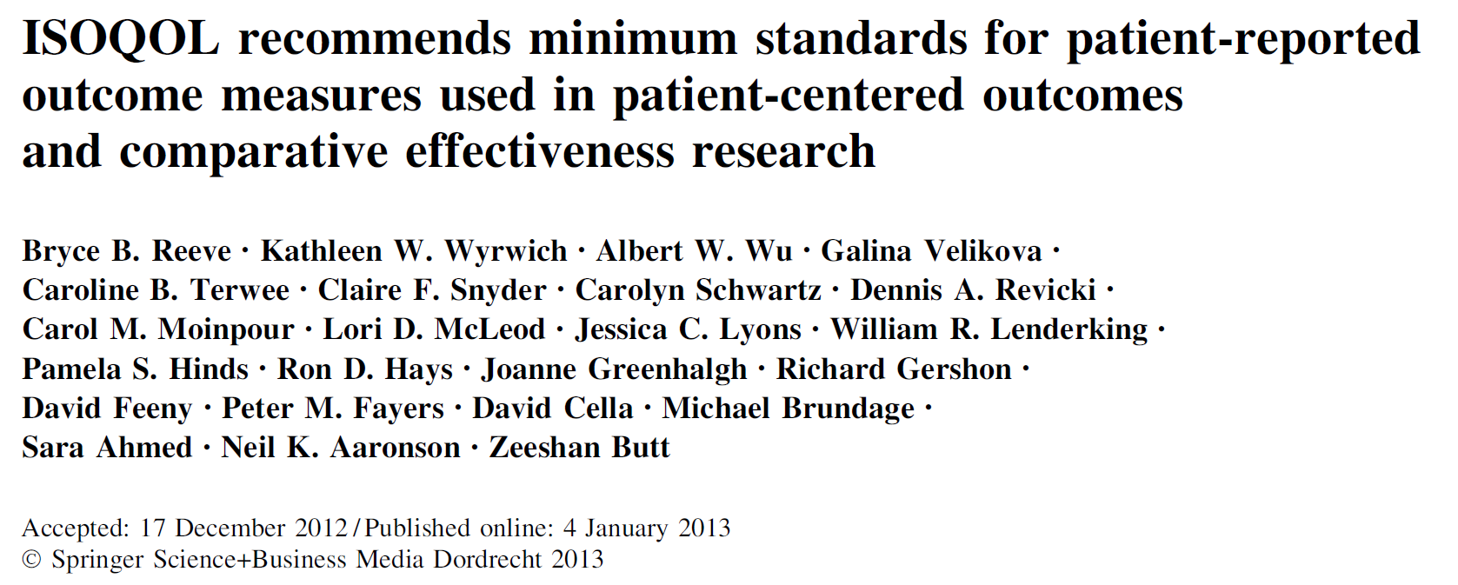
Measuring PROs Effectively
Conceptual and measurement model, including intended population
Reliability
Validity (content, construct, responsiveness)
Interpretability of scores
Translations
Patient and Investigator Burden
Reeve et al, Qual Life Res 2013, 22, 1889-1905
Notes:
MK to CS/MB:
this slide needs better formatting & spacing – too much white space in the image box, I suggest replacing top bit with text box including citation details (standard PROTEUS citation formatting), and include the QOLR journal cover for a bit of colour?
Shorten header to just ‘Publication’ – for this and corresponding slides for other resources?
CS&MB: reminder to take off header – we don’t think it’s necessary, as it’s self-evident that these are publications
DC: Done
ALSO - another example of do we need a text box citation?
- Example of blue outline

Slide 53
Crossnohere et al, Qual Life Res 2021;30:21-40

Slide 54
Analyzing PRO Data Properly
Trial Protocol Development
Trial Accrual and Follow-up
Trial Analysis
Trial Reporting
Clinical Uptake of Trial Findings
High-Quality PRO Evidence
SPIRIT
PRO
Protocol
Guidance
ISOQOL
PRO
Measure
Selection Standards
PRO
Data Display Guidance
SISAQOL
Analysis
Guidance
CONSORT
PRO
Report
Guidance
Clinician
Users’
Guide

Slide 55
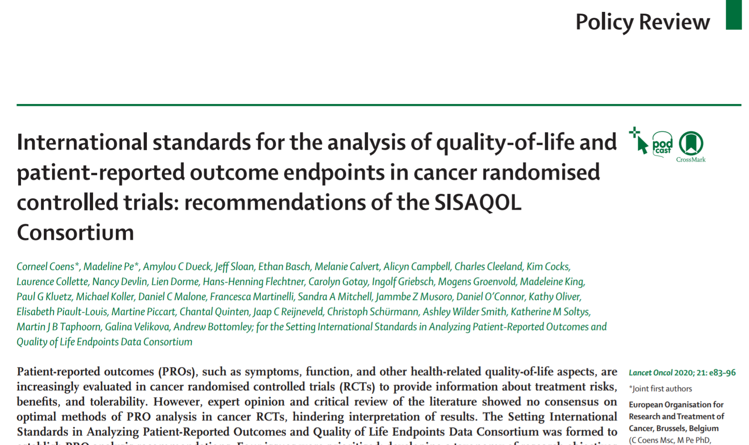
Analyzing PRO Data Properly
Objectives
  Broad (e.g., confirmatory comparisons vs. exploratory/descriptive)
  Between-arm (e.g., superiority or equivalence/non-inferiority)
  Expectation (e.g., improvement, worsening, overall effect)
  Endpoint (e.g., proportion of responders at time t)
Recommended statistical methods, e.g.:
  Cox proportional hazards for time-to-even
  Linear mixed models for magnitude-of-event, describe response patterns/profiles
Missing PRO data
  Handling analytically
  Collecting reasons
Coens, et al Lancet Oncol
2020, 21, e83-96
Notes:
DC: another example of do we need a text box citation? Black outline

Slide 56
Reporting the PRO Results Clearly (1)
Trial Protocol Development
Trial Accrual and Follow-up
Trial Analysis
Trial Reporting
Clinical Uptake of Trial Findings
High-Quality PRO Evidence
SPIRIT
PRO
Protocol
Guidance
ISOQOL
PRO
Measure
Selection Standards
PRO
Data Display Guidance
SISAQOL
Analysis
Guidance
CONSORT
PRO
Report
Guidance
Clinician
Users’
Guide

Slide 57
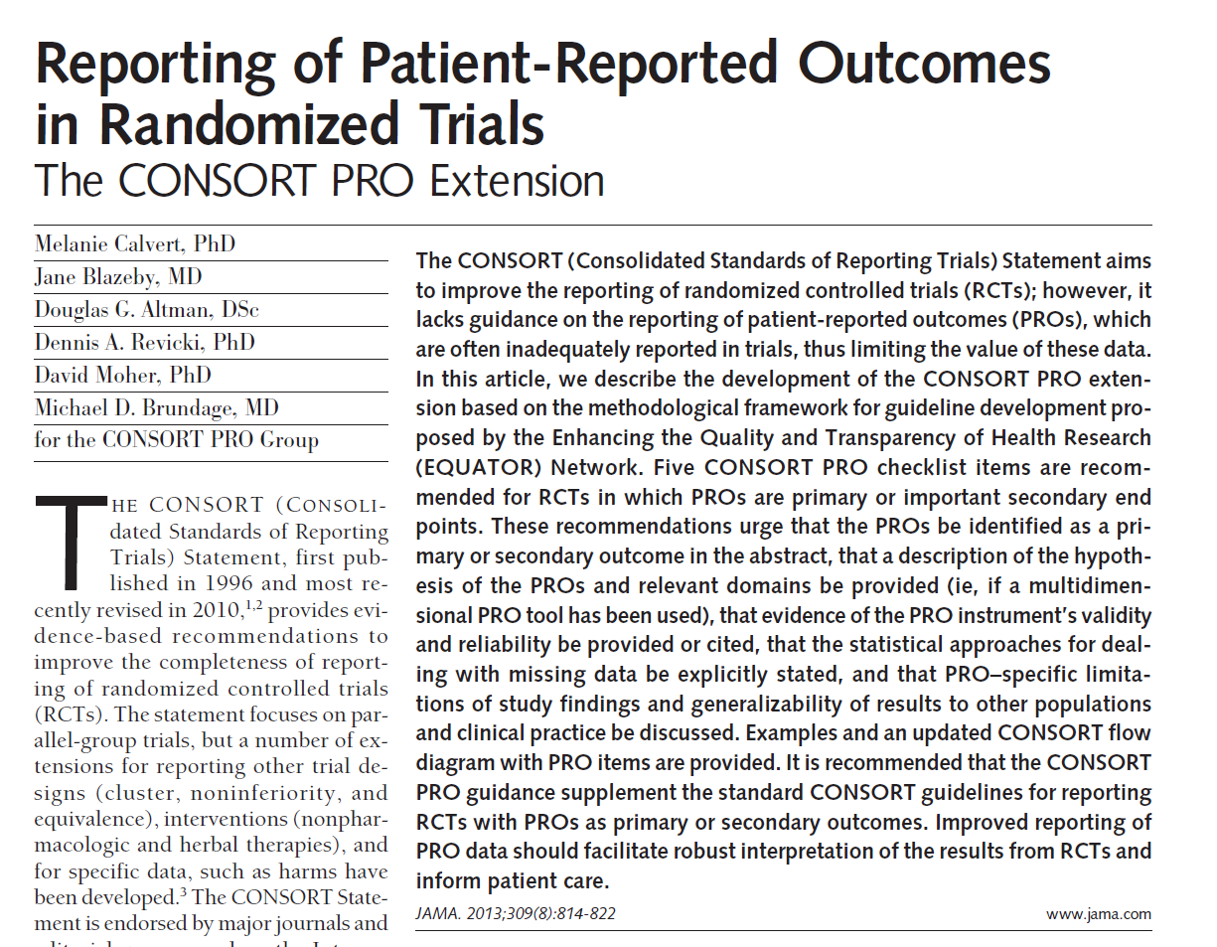
Reporting PRO Results Clearly (1)
Identify PRO as primary or secondary endpoint
State PRO hypothesis, specifying domains if applicable
Provide/cite evidence of PRO instrument validity and reliability
Summarize PRO data collection procedures
State statistical approaches for dealing with missing data
Address PRO-specific limitations and implications for generalizability
Calvert et al, JAMA
2013, 309(8), 814-822
Notes:
DC replaced blurry version with clearer version (new screen grab)
DC: another example of do we need a text box citation?

Slide 58
Reporting the PRO Results Clearly (2)
Trial Protocol Development
Trial Accrual and Follow-up
Trial Analysis
Trial Reporting
Clinical Uptake of Trial Findings
High-Quality PRO Evidence
SPIRIT
PRO
Protocol
Guidance
ISOQOL
PRO
Measure
Selection Standards
PRO
Data Display Guidance
SISAQOL
Analysis
Guidance
CONSORT
PRO
Report
Guidance
Clinician
Users’
Guide

Slide 59
Reporting PRO Results Clearly (2)
Directionality (whether higher scores are better or worse)
Conveying score meaning
Conveying statistically significant differences
Illustrating clinically important differences
Snyder et al, Qual Life Res
2019, 28(2), 345-356
Notes:
DC: another example of do we need a text box citation?

Slide 60

Reporting PRO Results Clearly to Patients
Notes:
CS&MB: Instead of text for slides 51 and 52, we’d prefer to include annotated figures: 1 line graph for patients and 1 line graph for clinicians/researchers.
RC: Have revised slides 51 &52 as per CS&MB feedback. It was difficult to fit multiple recommendations on the line graph for patients – can be modified further.
DC comment on CS/MB version 15 Sept: Nice! FINAL

Slide 61
Reporting PRO Results Clearly to Clinicians/
Researchers
Notes:
CS&MB: Instead of text for slides 51 and 52, we’d prefer to include annotated figures: 1 line graph for patients and 1 line graph for clinicians/researchers.
RC: Have revised slides 51 &52 as per CS&MB feedback. It was difficult to fit multiple recommendations on the line graph for patients – can be modified further.
DC comment on CS/MB version 15 Sept: Nice! FINAL

Slide 62
Applying PRO Findings in Practice
Trial Protocol Development
Trial Accrual and Follow-up
Trial Analysis
Trial Reporting
Clinical Uptake of Trial Findings
High-Quality PRO Evidence
SPIRIT
PRO
Protocol
Guidance
ISOQOL
PRO
Measure
Selection Standards
PRO
Data Display Guidance
SISAQOL
Analysis
Guidance
CONSORT
PRO
Report
Guidance
Clinician
Users’
Guide

Slide 63
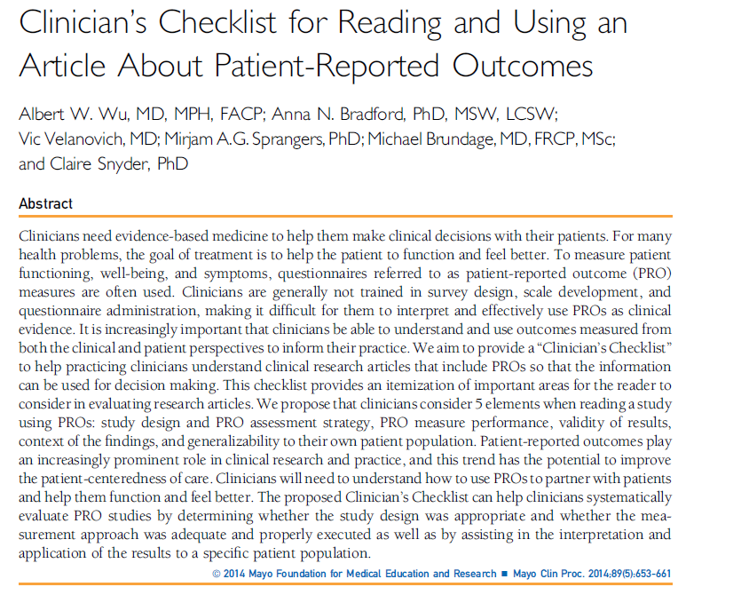
Applying PRO Findings in Practice
Was the PRO assessment strategy appropriate?
Did they measure PROs effectively?
Should I believe the results?
Were the results placed in clinical context?
Do the results apply to my patients?
Wu et al, Mayo Clin Proc
2014, 89(5), 653-661
Notes:
DC: another example of do we need a text box citation?
This is an example of screenshot without an outline.

Slide 64
Recommendations organized in three categories:
Always cover*
    Assumes 1 paragraph of space is available
Cover if PRO is a primary endpoint, or if a second paragraph of space is available*
Cover if space allows
*example text provided
Snyder et al, BMJ
2021;373:n1367

Slide 65
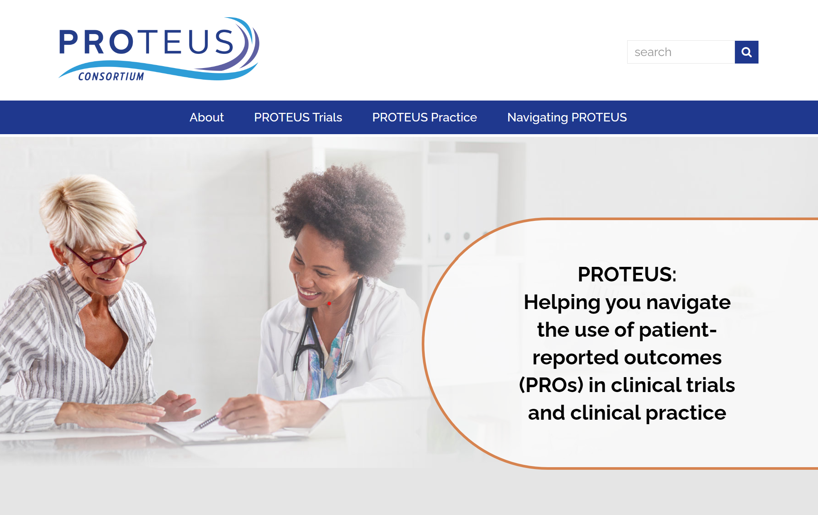
The PROTEUS Website
TheProteusConsortium.org

Slide 66
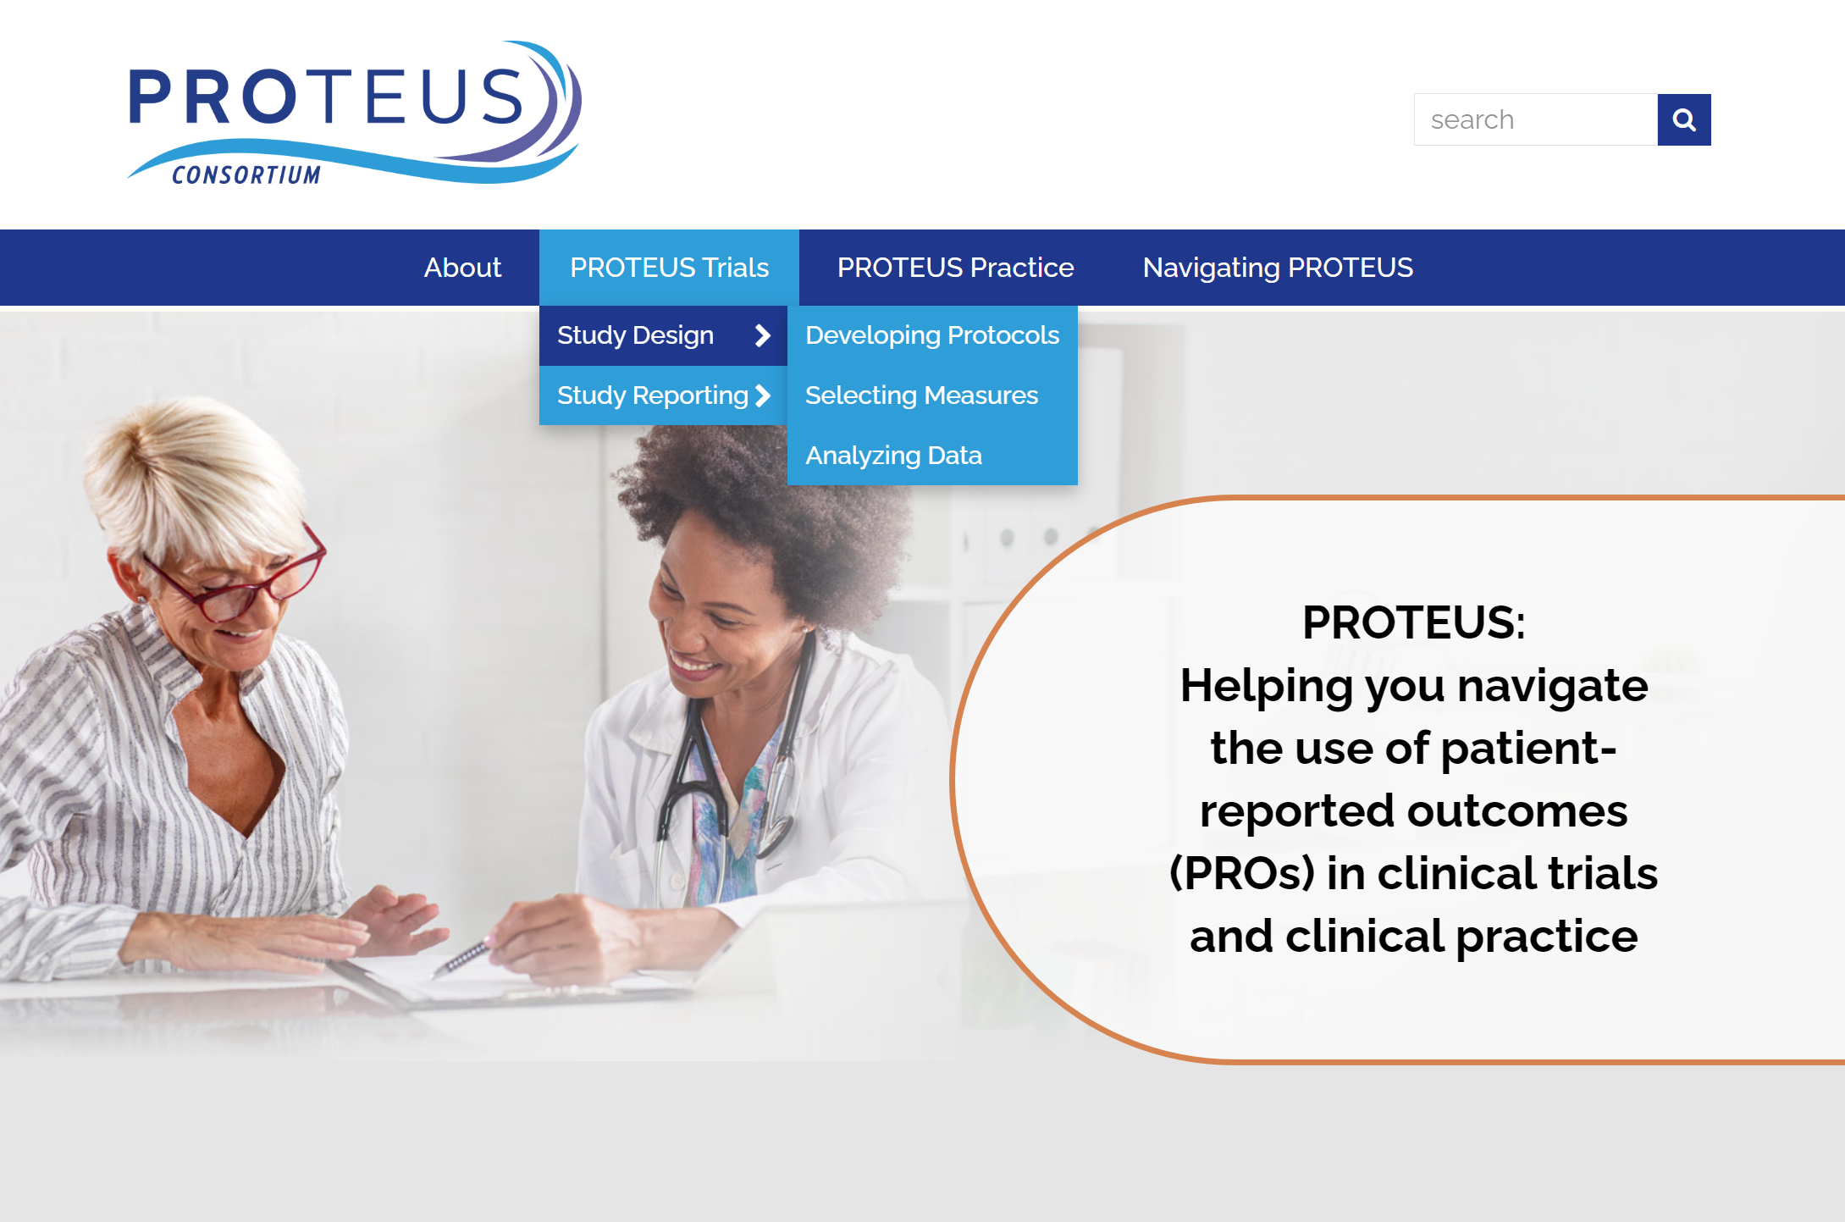


Slide 67
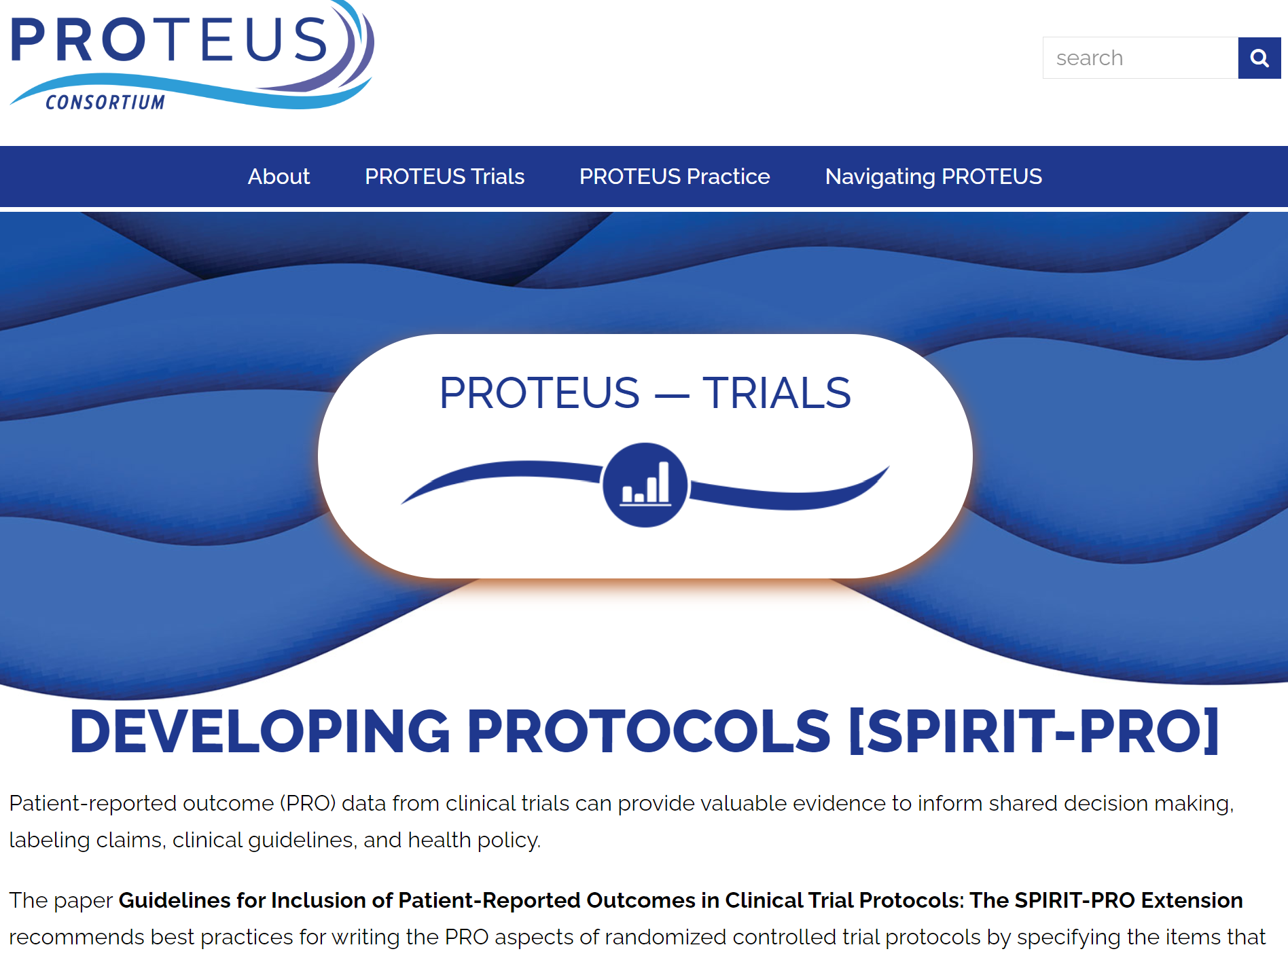
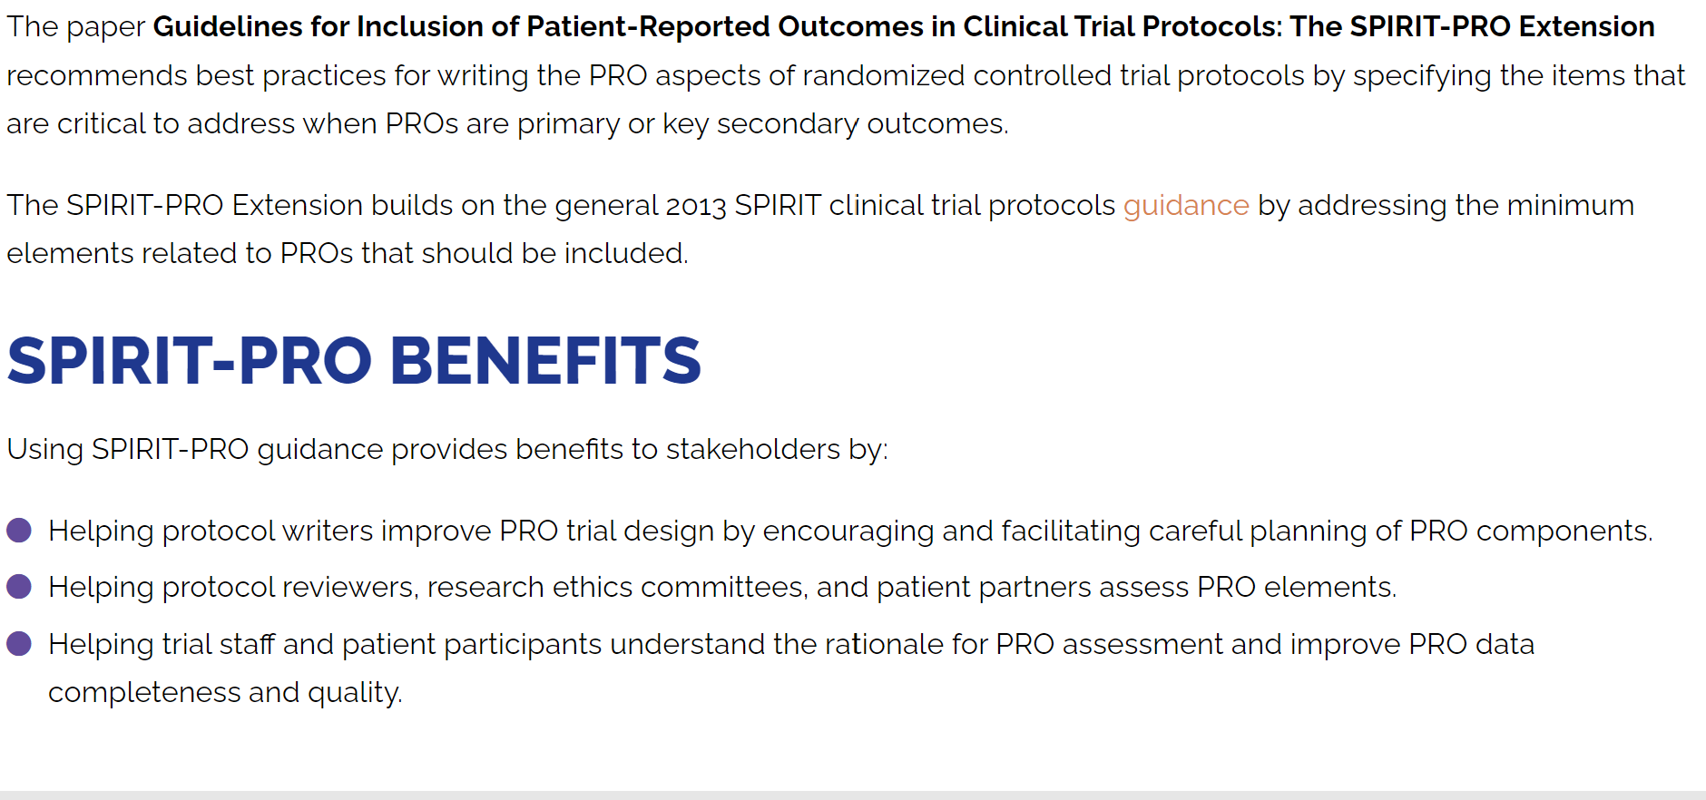
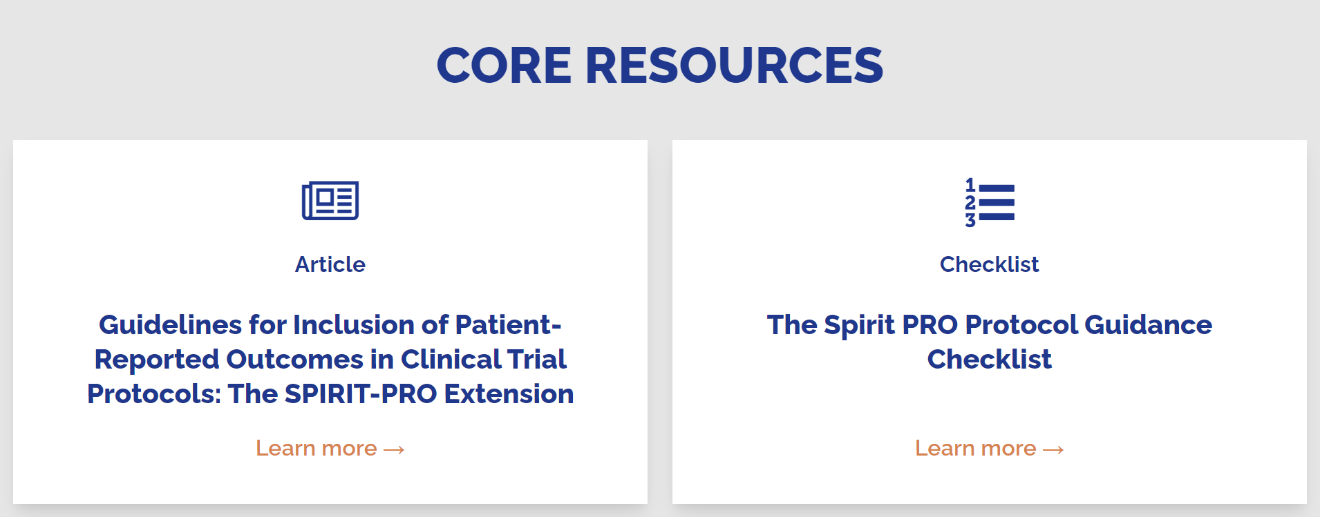

Slide 68
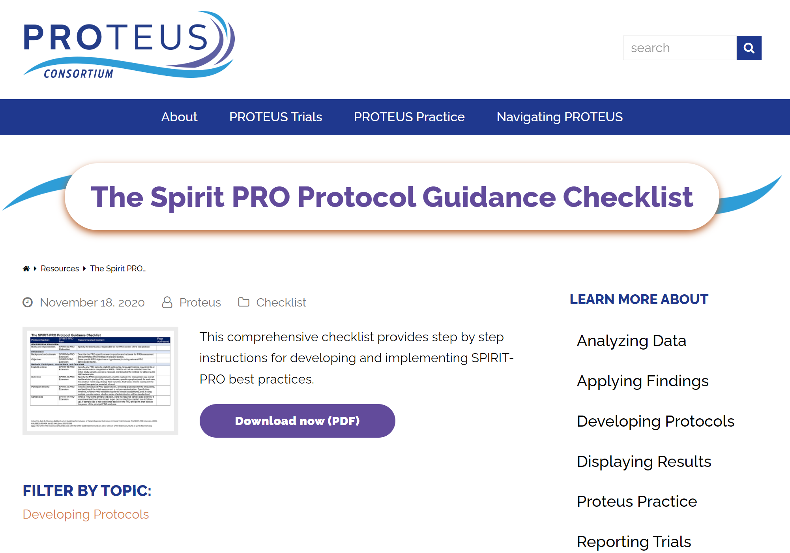

Slide 69
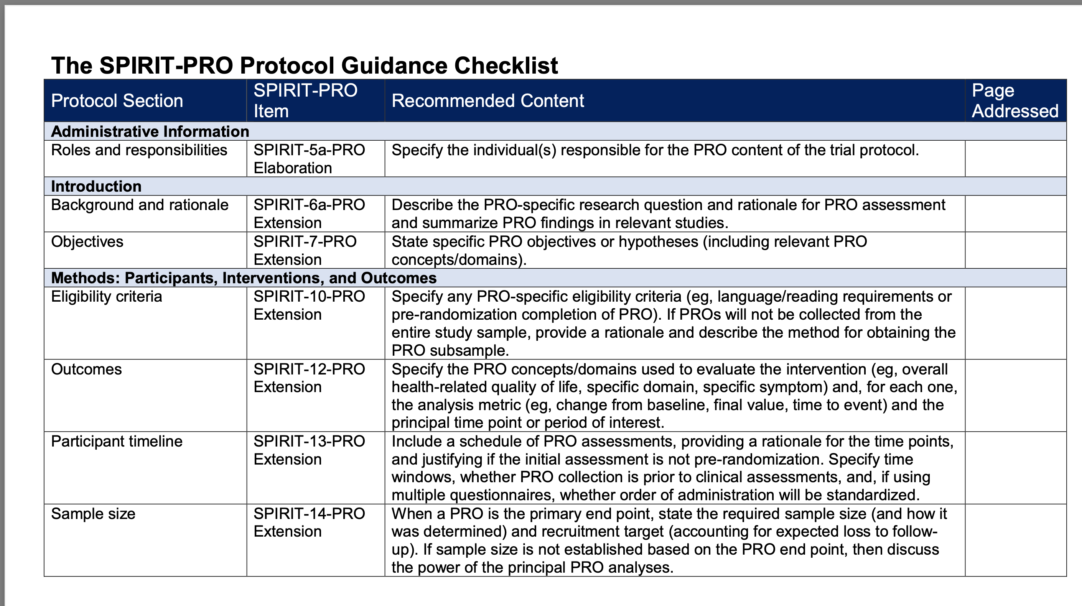

Slide 70
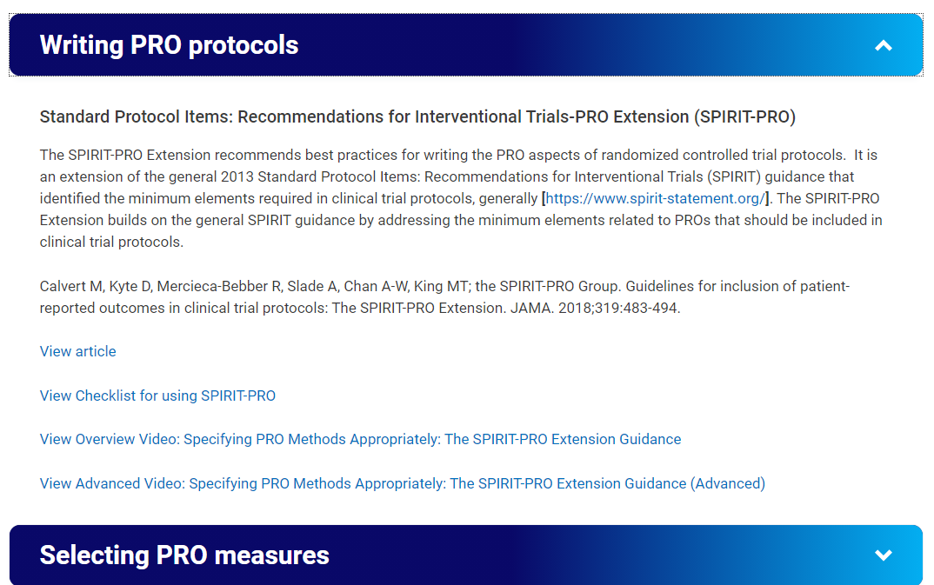
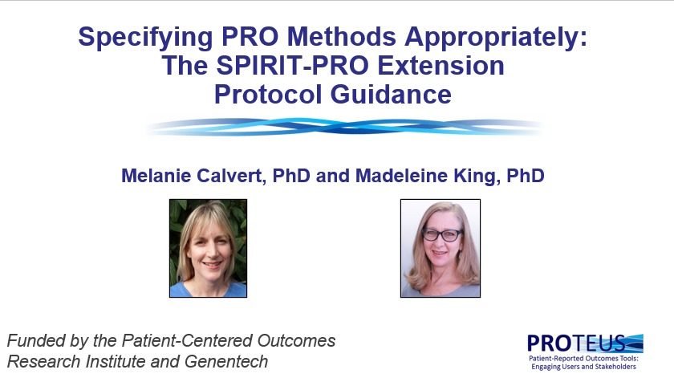

Slide 71
Overview of Web Tutorials
Introduction to PROs and PROTEUS
Introduction to the PROTEUS Tools
Introduction to the PROTEUS Tools
Trial Protocol Development
Trial Accrual and Follow-up
Trial Analysis
Trial Reporting
Clinical Uptake of Trial Findings
High-Quality PRO Evidence
SPIRIT
PRO
Protocol
Guidance
ISOQOL
PRO
Measure
Selection Standards
SISAQOL
Analysis
Guidance
PRO
Data Display Guidance
CONSORT
PRO
Report
Guidance
Clinician
Users’
Guide
Overview of Tool Recommendations
How to Apply the Tools

Slide 72
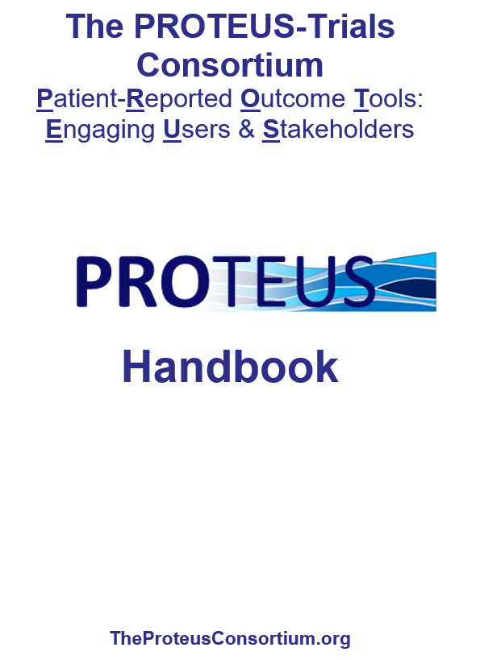

Slide 73
Conclusions
PROs often add value by providing information from the patient perspective that cannot be otherwise ascertained
Valid PROs that can inform clinical application require rigorous scientific methods to be employed in design, conduct, analysis and reporting of the clinical trial
Multiple tools are available to help investigators work with PRO scientists and biostatisticians to ensure high-quality and valid PROs

